Slide 1
Software Development
Street Credibility for Cybersecurity Practitioners

Slide 2
What We Will Discuss
Provide developer perspective – what security looks like
What can help – “Street Credibility”
“lay of the land” in software technologies
Code examples, including exploits
Add real world context to the CISSP section on software

Slide 3
My Background
~20 years of experience in software… By way of finance
Big, Small, and In Between – GE, My own “social network”
Most Professional Work – Java/Oracle/Web
Favorite: Python/Data
Now: Not my day job, but a fun hobby

Slide 4
My Results: CISSP – Chapter 8 Practice Test
70%
(Fail)

Slide 5
A Few Other Things
Notes are optional – not sure how much this will help on the test
I hope it helps when you are out there working
Please ask questions at any time
The test will take some real study
Good breadth and background (Mixed with nitpicking)
Feel free to email me (josh.martin@gmail.com)

Slide 6
Software Perceptions of Cybersecurity
Want to be involved early in the process
Why not?
Gas versus Brakes
“No machine”
Checklists without understanding
Slow, Manual Processes

Slide 7
What COULD help
Technical Know-How
Side projects, Open Source, Hobby (Raspberry Pi Network)
Helping team get to Yes
Automation (more on this later)
No Waiting Lists
Light Touch

Slide 8
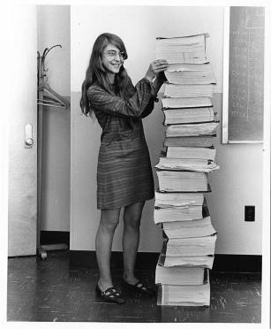

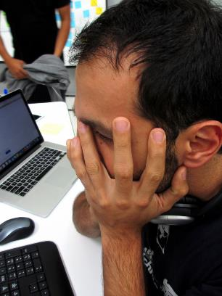
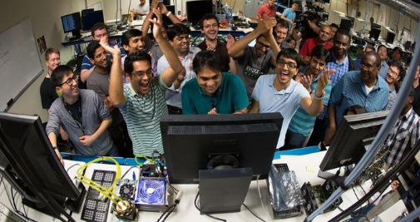
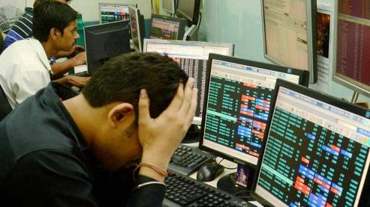
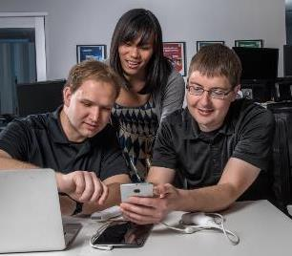
“Street Credibility”
Failure
Success
Nostalgia

Slide 9
Software Development 101
Decide What To Build (Requirements, Stories)
Build It (Coding, Compiling, Testing, Packaging)
Web and Mobile are main modern interfaces
Still Have Client / [Server], Too
Deploy It (No Longer on Laptop)
Test More
Promote It (to Production)

Slide 10
Web/Browser Technologies
HTML: Hypertext Markup Language – The Layout
HTML5 adds some good new features (Video, Workers, Data)
CSS: Cascading Style Sheet – The Look
Responsive Design
Javascript – Dynamic behavior (without page Reloads)
Is Javascript a Programming Language?

Slide 11
Middleware
Middleware resides on the server (not browser)
Talks to Data sources (databases, Files, Web Services)
Modern Javascript in Browsers can also call Web Services
Business Logic, Security, Integration, Services
Languages: Java, C#, Python, Ruby, C++, Javascript*
Need a Container to run code (Tomcat, Node, etc.)

Slide 12
The “Backend”
Traditionally, a relational database (e.g. Oracle, Postgres, MySql)
Also have NoSql Options (Mongo, Dynamo, Redis)
Also Have Unstructured Data – Images, Files

Slide 13
A note on mobile
Middleware and Backend have the same options
Front-end is usually mobile web (responsive) or Native
Android is a Java-based Environment (with some C)
Apple uses Objective C or Swif

Slide 14
The Build

Slide 15
Deployment

Slide 16
Testing

Slide 17
The Buzz

Slide 18
Cloud

Slide 19
Agile

Slide 20
DevOps

Slide 21
SECDevOps

Slide 22
Putting It Together
Spin up server
Install Java
Install Tomcat
Install Maven
Install Git (configure Security)
Pull Code We Showed
Build and START

Slide 23
Vulnerability Hunt

Slide 24
YYYYYYYYYYYYY

Slide 25
YYYYYYYYYYYYY

Slide 26
YYYYYYYYYYYYY

